Slide 1

Impacts of COVID-19 and Climate Change on Indigenous Peoples.
Kamala Thapa
Nepal

Slide 2
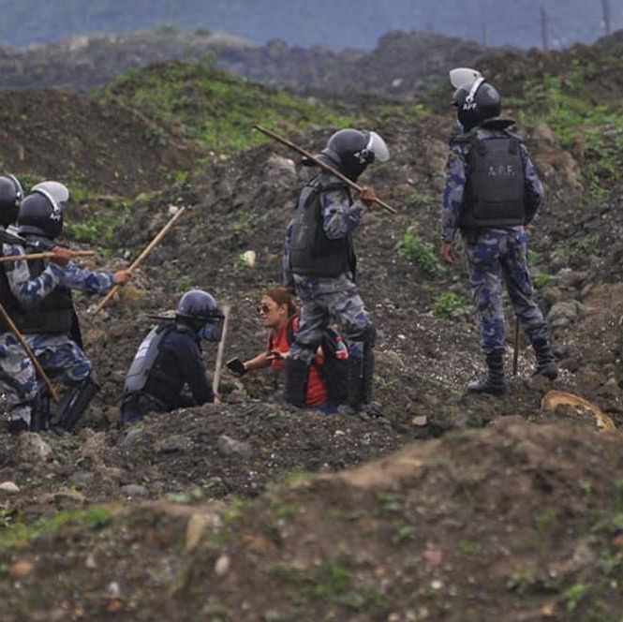
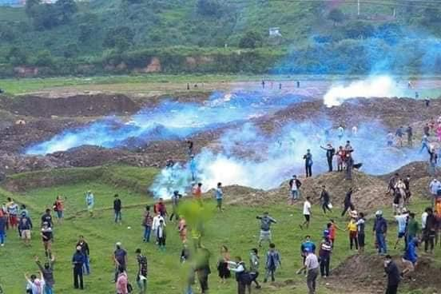
COVID-19 and Indigenous Peoples
In high risk of COVID 19 because of factors such discrimination, social exclusion, land dispossession, militarization
Deprived from safety health
Increase gender base violence including rape cases
High impact of climate disaster
Displacement of Indigenous Peoples from their customary land
Lack of access to information on COVID-19 in own language
Structural inequalities

Slide 3
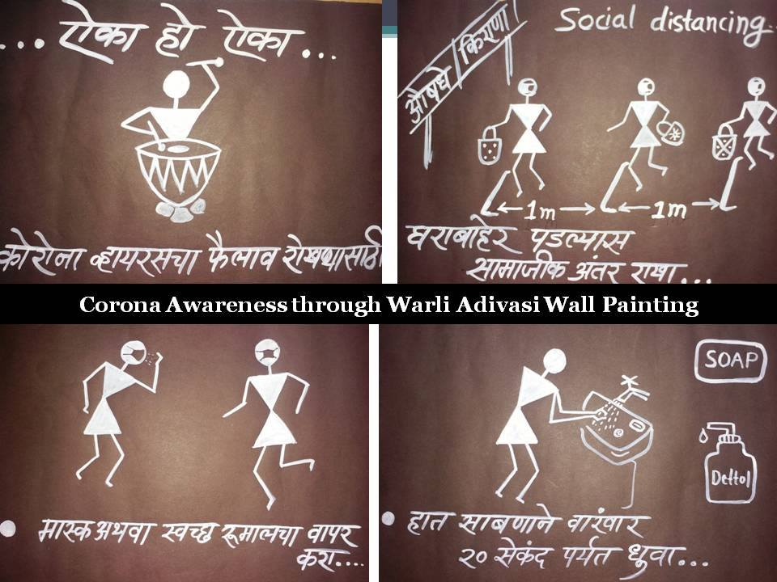
COVID-19 and Climate Change and Indigenous Peoples
Climate change is happening as a result of human activity – namely industrial production- Human are harvesting the natural resources- forest, water, fossil fuels, land, etc
Process depletes the natural ability of the environment to balance itself and disrupts ecological cycles- deforestation,
Due to the geography and location of living of Ips- are must vulnerable to CC because they sit on the frontline of the physical effects of the climate driven extreme weather
Indigenous Peoples Fundamental rights to life, health, water, food, adequate standard of living, land, culture and traditional are undermined both by the climate crisis and by the COVID 19 pandemic.

Slide 4
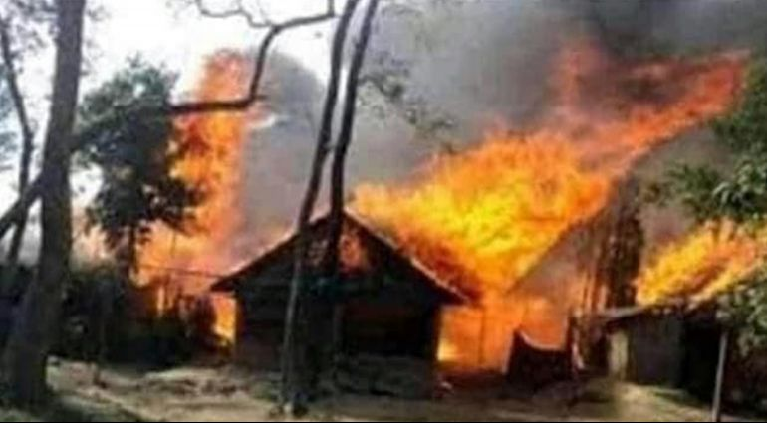
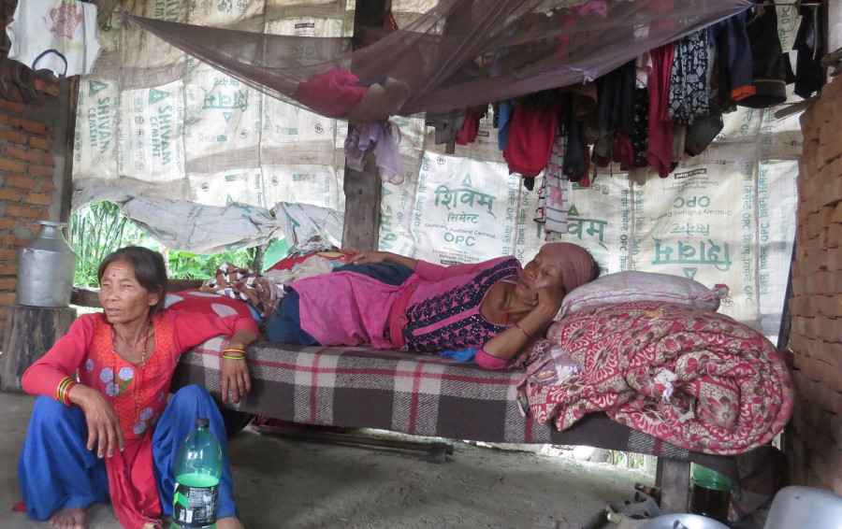
Right to land, natural resources and prevention of cultural heritage
Indigenous Peoples customary lands are changing in different form in the name of economic development of state: Hydropower, National Parks, Protected areas, conservations areas, mining, fast track road constructions etc- no access to their own resources, if they go to collect- they were criminalized, they were charged as illegal suspects, etc
Illegal land seizure during lock downs, among others has affected Indigenous Peoples rights to land and natural resources resulting sometimes in their livelihoods, cultures and traditions being destroyed-
  Case I: Khokana Village, Historic place of Newar Ips
  Case II: Chitawan National park- Chepang
Picture from: Kantipur news and Indigenous TV wen[age

Slide 5
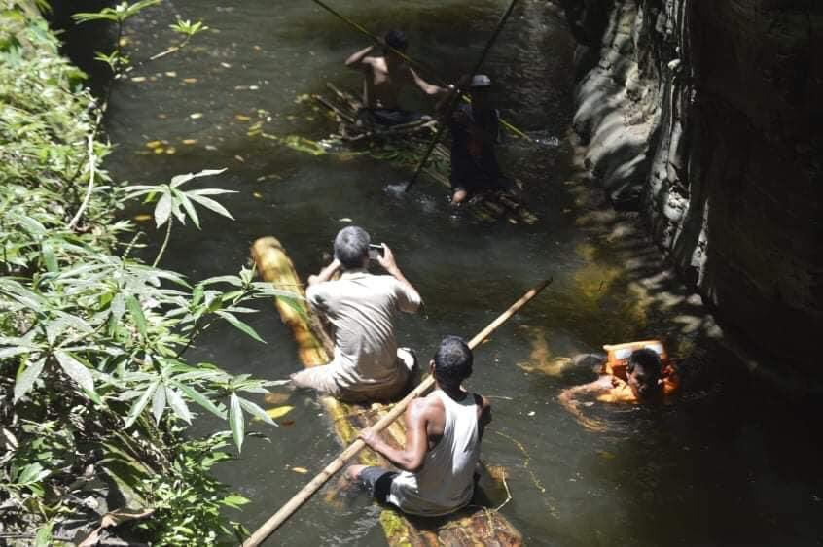
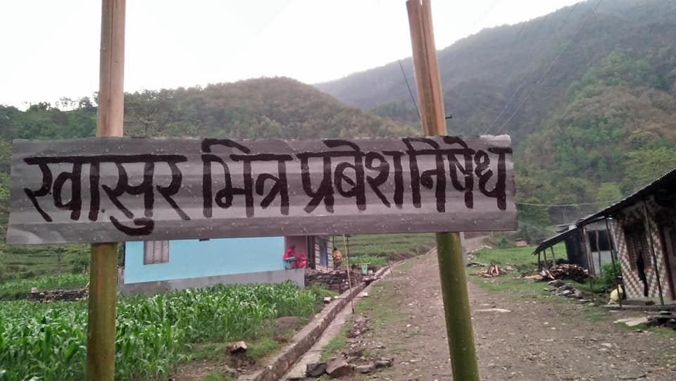
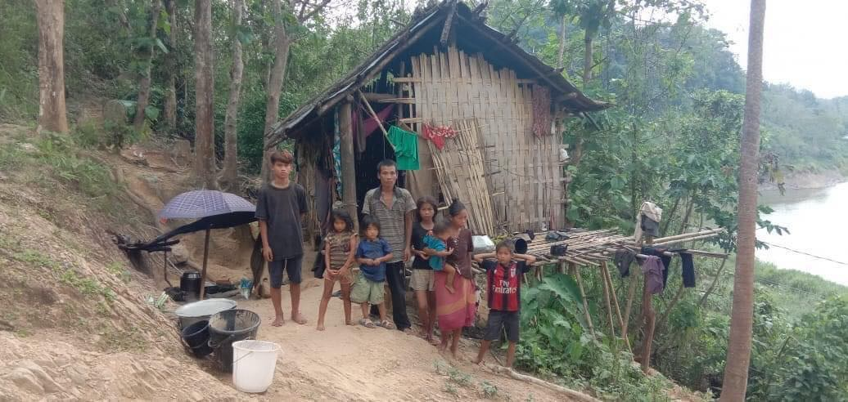
Why Indigenous Peoples should be counted?
As Human being on earth, every human being has equal rights to live on.
We are not the problem, we are the part of Solution: we have collective way of life, we have distinct culture, Traditions, spiritual values and believes
We are custodians of lands, territories, and resources, and holders of Indigenous Knowledge which contribute to exist sustainability of Earth.
But
the national laws and policies and planning process are not favouring to ensure Indigenous Peopels rights, rights to participation in the process that ultimately hinder in their livelihoods, cultures, traditions, lands, territories and resources and identity.
Basically
Existing legal provisions and procedure are obstacle for indigenous peoples to claim and enjoy their rights at the national and local level even though there are favourable legal provisions of international human rights instruments pertaining to indigenous peoples rights: those are not implementing

Slide 6
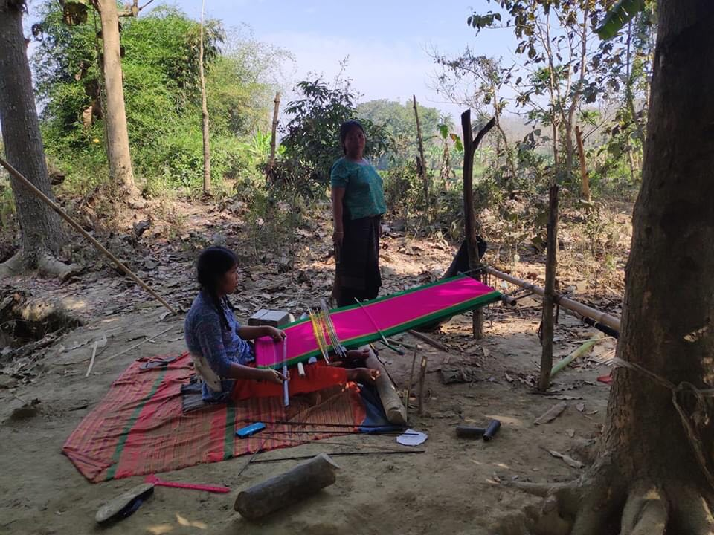
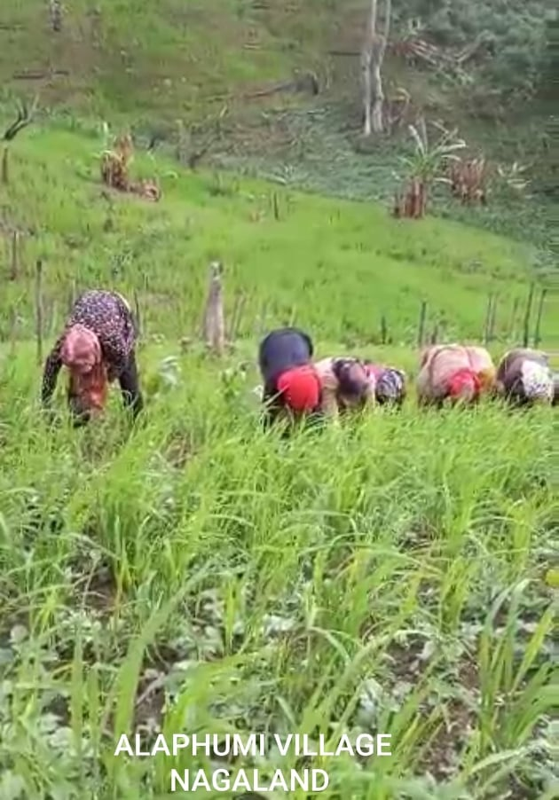
Way Forward:
Ensure right to self determination, full and meaningful participation in every decision making in all level.
Recognized Indigenous Data processing methodology- by recognizing customary institutions in the legal provision.
Ensure free, prior and informed consent to protect collective ways of life and collective rights of Indigenous Peoples
Recognize, protect and replicate Indigenous Peoples knowledge and practices: Nature based solutions to global challenges
In-depth studies and documentations with disaggregated data and analysis, and design cultural sensitive approach to overcome the socio-economic, Cultural, environmental and political impacts .
Earmark Resources and support building strong network of Indigenous Peoples at global, regional, national and local level

Slide 7
Cont..
The vulnerability of Indigenous Peoples to:
social, economic, Cultural and environmental shocks linked to climate change can be significantly reduced by recognizing and securing Indigenous Peoples’ collective rights to lands, natural resources, culture heritage, and free, prior, and informed consent to prevent customary land grabbing.

Slide 8
Thank You!!

